Slide 1
Mobile Application Development
Android Overview

Slide 2
Mobile by the Numbers
7.7 billion people on the planet
8.9 billion mobile connections
5 billion unique mobile phone users
Ref: https://www.bankmycell.com/blog/how-many-phones-are-in-the-world
Notes:
- "That phenomenon is easily visible in Indonesia, for example, where it is common to see people who live in metal roofed shacks without bathrooms surfing Facebook on their smartphones or feature phones. And it shows how, in the developing world, multinationals are often better at responding to peoples’ needs than governments are."
- Mobile phone !- smart phones
Sources:
World population: http://www.worldometers.info/world-population/
Mobile phone vs. toilet: http://newsfeed.time.com/2013/03/25/more-people-have-cell-phones-than-toilets-u-n-study-shows/

Slide 3
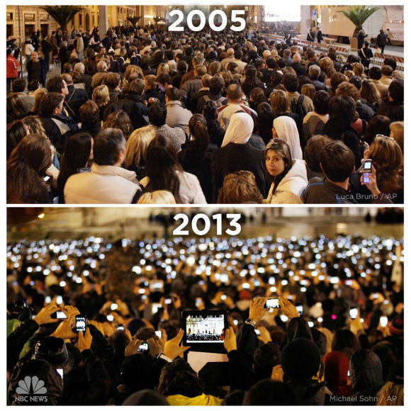
Notes:
2005 announcement of Pope Benedict XVI and the 2013 announcement of Pope Francis
Type 1 observation: Many more mobile devices.
Type 2 observation:
- About a basic need to share
- Way to record information

Slide 4
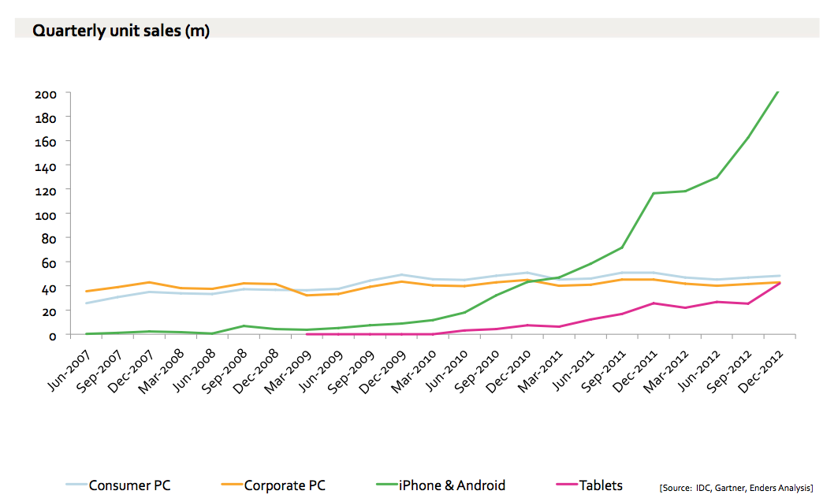
Mobile devices vs PC sales
Notes:
Source: Benedict Evans
http://publishersforum.de/wp-content/uploads/2013/04/BenedictEvans_MobileExplosion.pdf

Slide 5
What is Android?
A software stack for mobile devices that includes
A free, open-source mobile OS (15 years)
An open-source development platform for creating apps (Android Studio)
Google owns Android
Android was developed using the core code of open-source Linux
Uses Linux to provide core system services
Security
Memory management
Process management
Power management
Hardware drivers
Notes:
What is OS?
an operating system is computer software that works to integrate hardware and software resources. It allows for different types of hardware to work together while simultaneously providing a platform for various bits of software to work with that hardware and, consequently, other pieces of software.
If that’s still confusing, think of the analogy of a stage play. To put on a play, you’ll need a stage, lights, microphones, and other pieces of hardware. You’ll also need actors, stage crew, ushers, and other workers, which would be analogous to software. In this analogy, the director of the play would be similar to an operating system, as they would act as a conduit that instructs everything on how to work together. Without the director, you’d just have a ton of unused hardware with a bunch of people running around with no idea what to do.
In the case of smartphones, Android acts as the “director” for the unique hardware in your phone and the apps you’ve chosen to install.
2) When something is open source it means the copyright owner allows its use for any purpose, without any need for financial remuneration.
3) History: Believe it or not, Android started out as software for cameras. Andy Rubin and his team developed Android starting in 2003

Slide 6
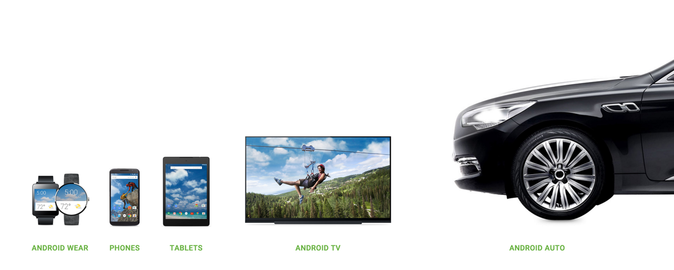
Android for different devices

Slide 7
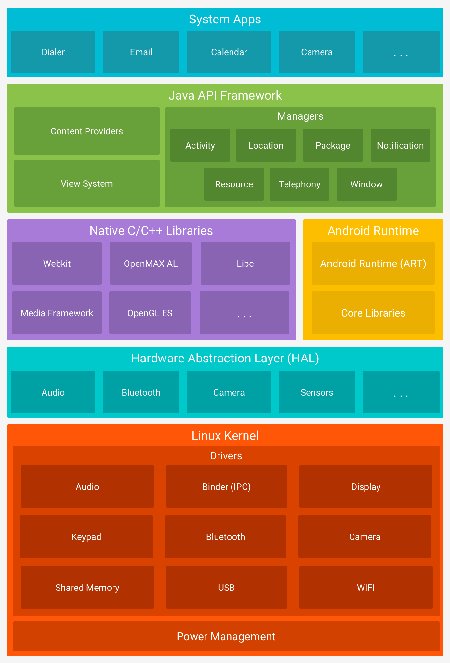
Android Platoform Architecture
See: An Overview of the Android Architecture https://developer.android.com/guide/platform/
Notes:
1. Linux kernel is the foundation of Android platform
ART depends on Linux Kernel for threading and low-level memory management
Using a Linux kernel allows Android to take advantage of key security features (permission, cryptography, rooting, sandbox) and allows device manufacturers to develop hardware drivers for a well-known kernel.
2. The hardware abstraction layer (HAL) provides standard interfaces that expose device hardware capabilities to the higher-level Java API framework.
3. For devices running Android version 5.0 (API level 21) or higher, each app runs in its own process and with its own instance of the Android Runtime (ART). Previously it was Dalvik.
- Ahead-of-time (AOT) and just-in-time (JIT) compilation
- Better debugging support, detailed diagnostic exceptions and crash reporting, and the ability to set watchpoints to monitor specific fields
4. The entire feature-set of the Android OS is available to you through APIs written in the Java language.
5. Android comes with a set of core apps for email, SMS messaging, calendars, internet browsing, contacts, and more.
he system apps function both as apps for users and to provide key capabilities that developers can access from their own app. For example, if your app would like to deliver an SMS message, you don't need to build that functionality yourself—you can instead invoke whichever SMS app is already installed to deliver a message to the recipient you specify.

Slide 8
Android Features
Application framework enabling reuse and replacement of components
Integrated browser based on the open source WebKit engine
Optimized graphics powered by a custom 2D graphics library; 3D graphics based on the OpenGL ES 1.0 specification (hardware acceleration optional)
SQLite for structured data storage
Media support for common audio, video, and still image formats (MPEG4, H.264, MP3, AAC, AMR, JPG, PNG, GIF)
GSM Telephony (hardware dependent)
Bluetooth, EDGE, 3G, and WiFi (hardware dependent)
Camera, GPS, compass, and accelerometer (hardware dependent)
Rich development environment including a device emulator, tools for debugging, memory and performance profiling, and a plugin for the Eclipse IDE

Slide 9
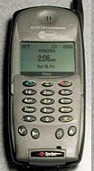
A Short History Of Android
2001 Palm Kyocera 6035, combing PDA and phone
PDA = personal data assistant, PalmPilot
2003 - Blackberry smartphone released
2005
Google acquires startup Android Inc. to start Android platform.
Work on Dalvik VM begins
2007
Open Handset Alliance announced
Early look at SDK
June, iPhone released
2008
Google sponsors 1st Android Developer Challenge
T-Mobile G1 announced, released fall
SDK 1.0 released
Android released open source (Apache License)
Android Dev Phone 1 released

Slide 10
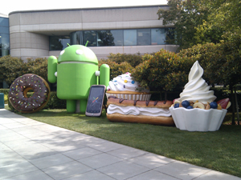
Short History cont.
2009
SDK 1.5 (Cupcake) after Alpha and Beta
New soft keyboard with “autocomplete” feature
SDK 1.6 (Donut)
Support Wide VGA
SDK 2.0/2.0.1/2.1 (Eclair)
Revamped UI, browser
2010
Nexus One released to the public
SDK 2.2 (Froyo)
Flash support, tethering
SDK 2.3 (Gingerbread)
UI update, system-wide copy-paste
https://en.wikipedia.org/wiki/Android_version_history

Slide 11
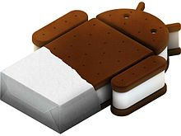
Short History cont.
2011
SDK 3.0 (Honeycomb) for tablets only
New UI for tablets, support multi-core processors, fragments
SDK 3.1 and 3.2
Hardware support and UI improvements
SDK 4.0 (Ice Cream Sandwich)
For Q4, combination of Gingerbread and Honeycomb

Slide 12
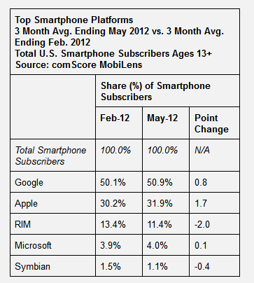
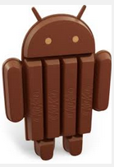
2012
Android 4.1, "Jelly Bean" released in July
2013
Android 4.4, KitKat released October 31, 2013
Short History cont.

Slide 13
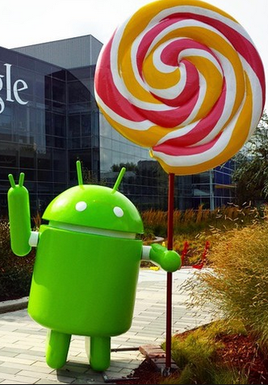
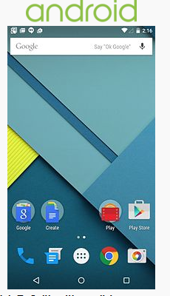
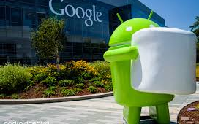
Short History (Getting Longer)
November, 2014 Android 5.0 Lollipop released. API level 21 "Material Design"
October, 2015 Android 6.0 Marshmallow API level 23

Slide 14
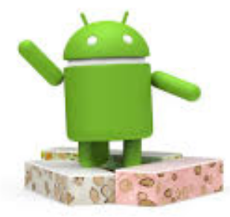
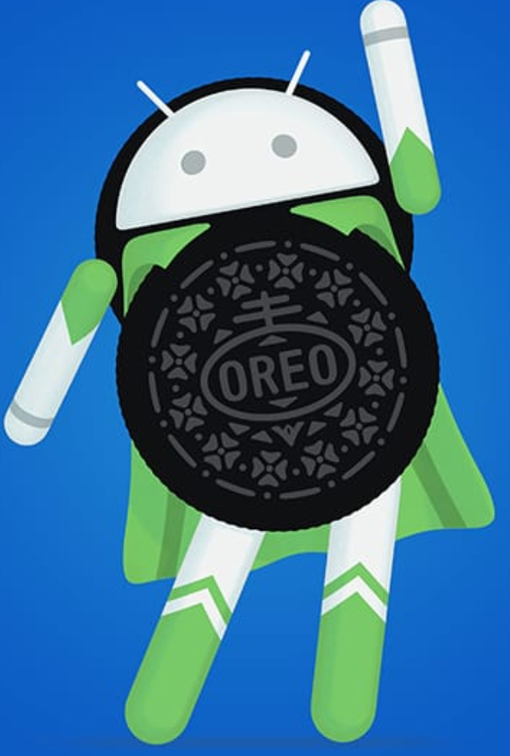
Still More
August 2016
Nougat
Daydream Virtual Reality Interface
Doze functionality to improve battery life
August 2017
Oreo
Jetpack, tools for building apps, common libraries and frameworks

Slide 15
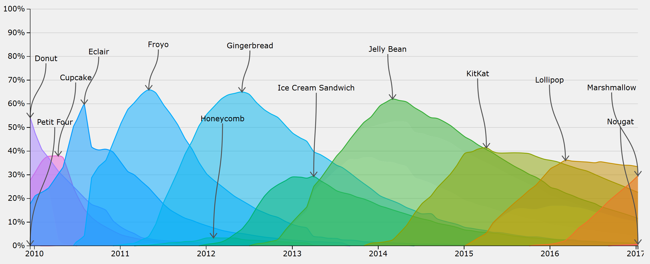
Dominant Version
http://www.bidouille.org/misc/androidcharts

Slide 16
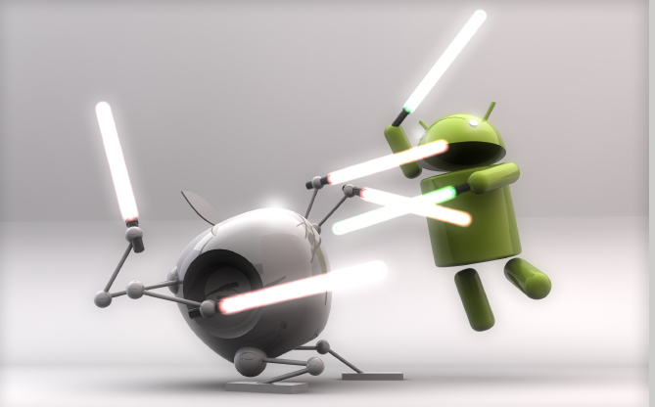
iPhone vs. Android

Slide 17
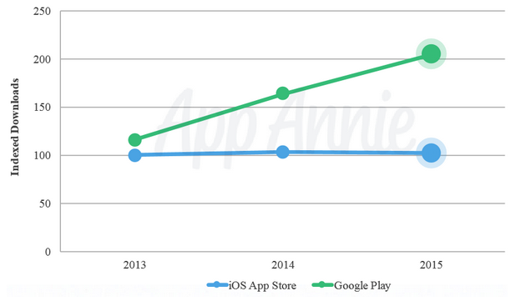
2015 App Downloads
https://www.appannie.com/

Slide 18
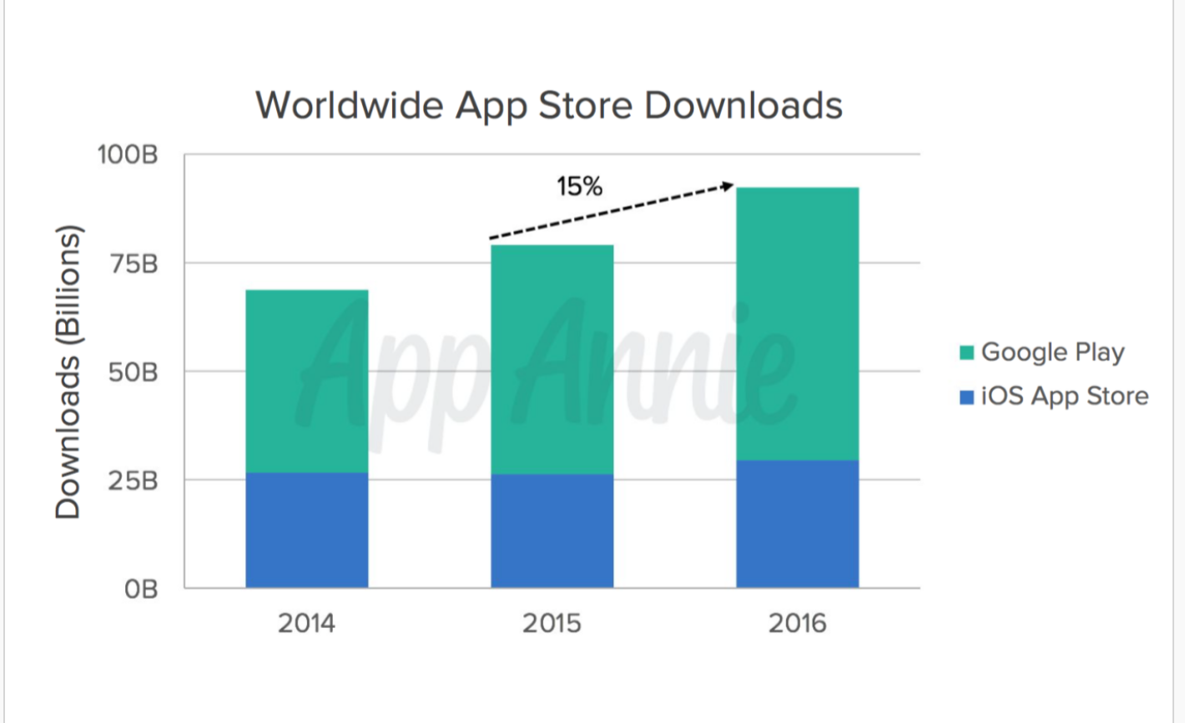
Android vs iOS

Slide 19
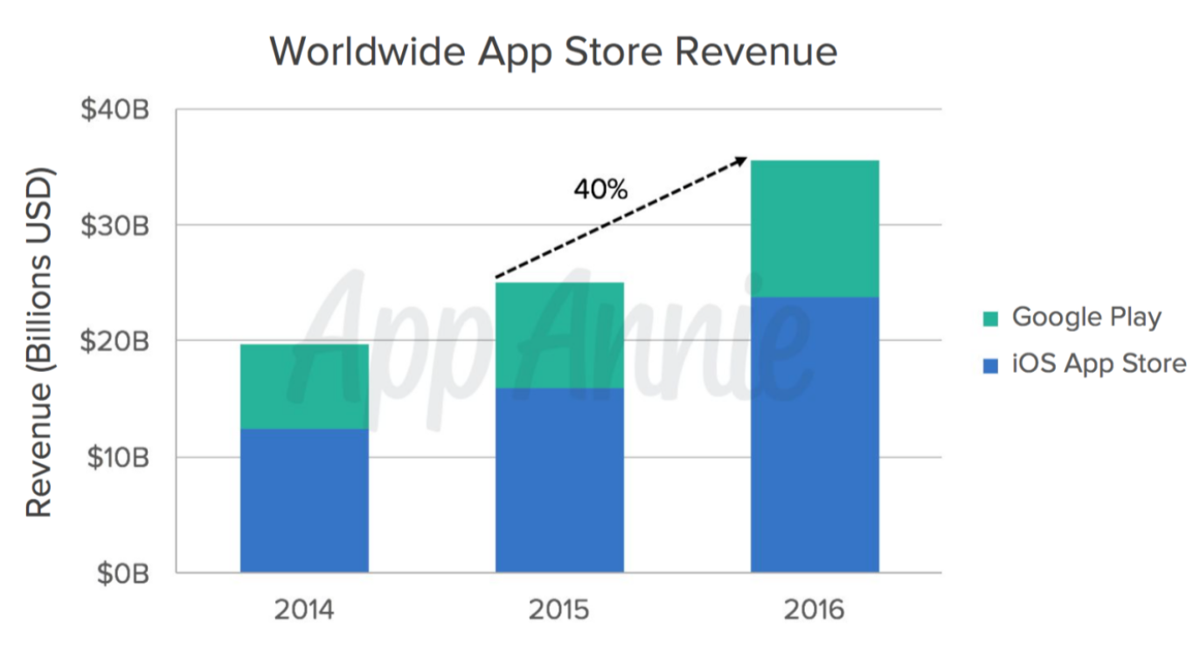
Revenue

Slide 20
Why Android?
Powerful and open SDK
No licensing fees
Thriving developer community
Low barrier to entry
Huge potential market of users

